Slide 1


Workplace Project
Avocado Prices and Sales Volume 2015-2023

Slide 2
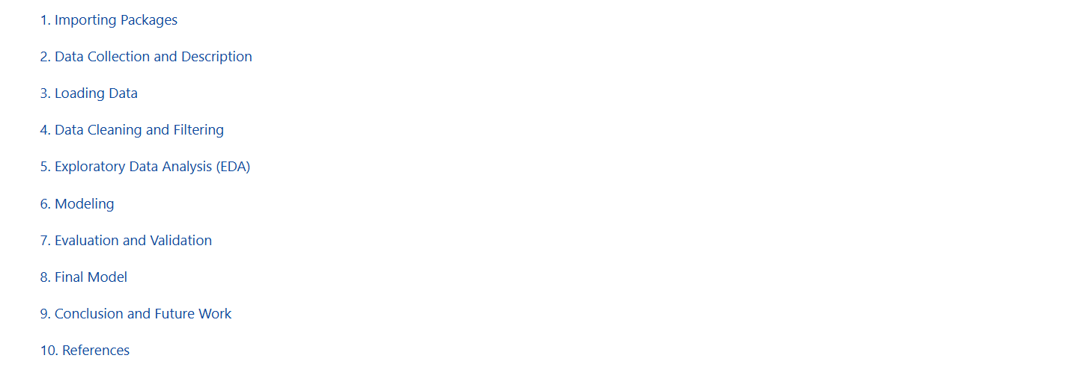
Table of Contents

Slide 3
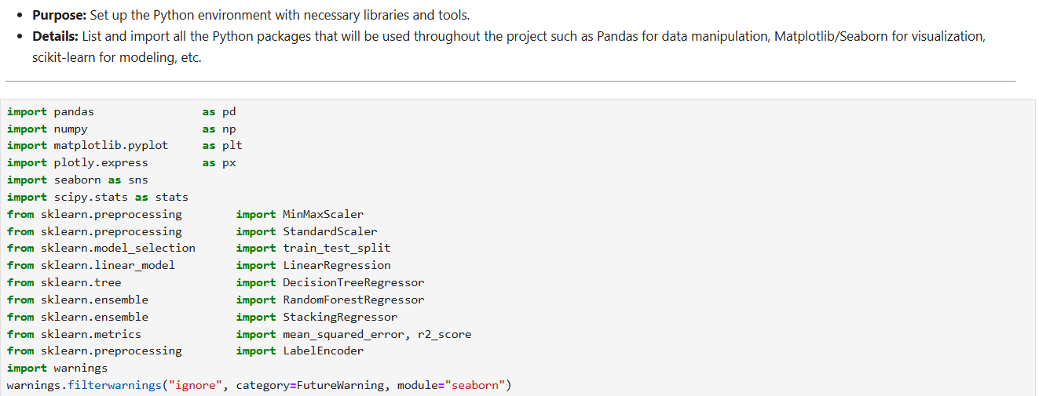
Importing Packages

Slide 4
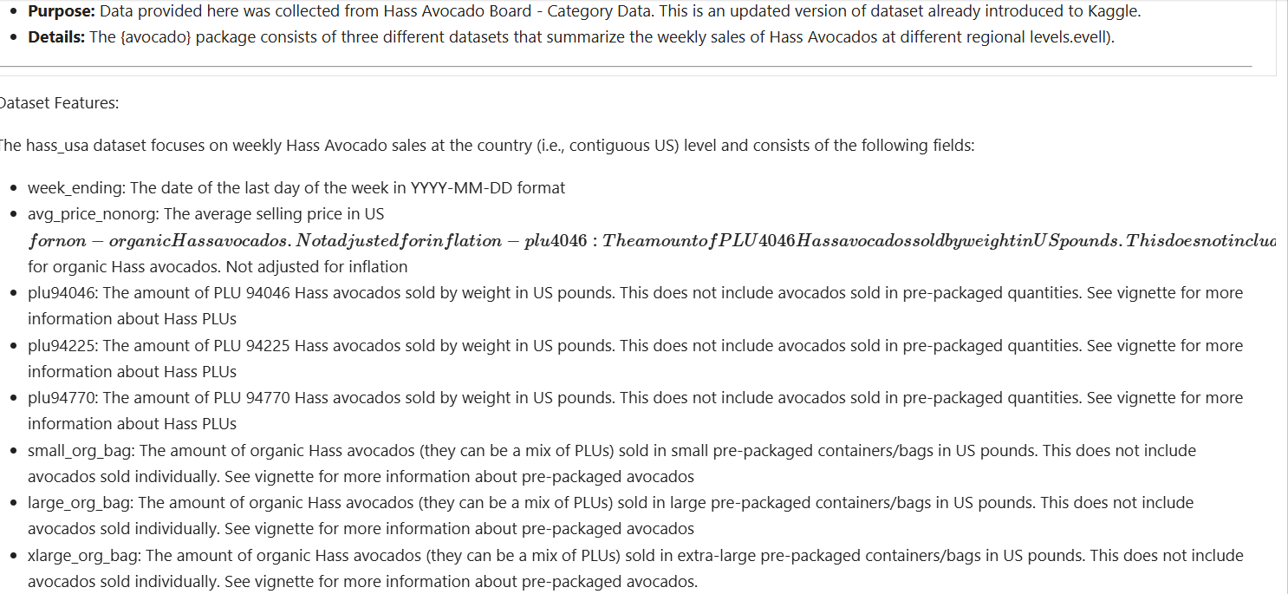
Data Description

Slide 5
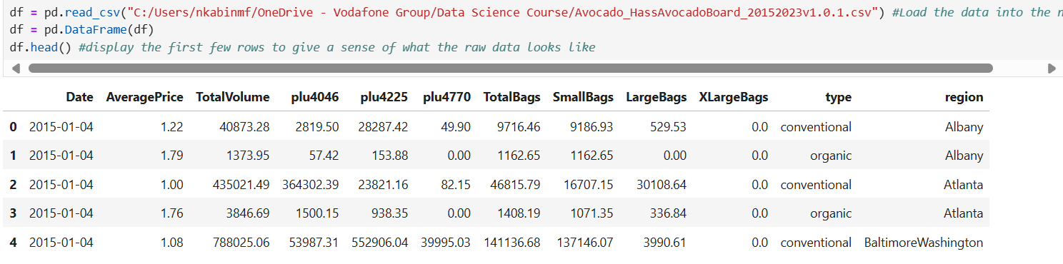
Loading Data

Slide 6
Data Cleaning and Feature Engineering

Slide 7
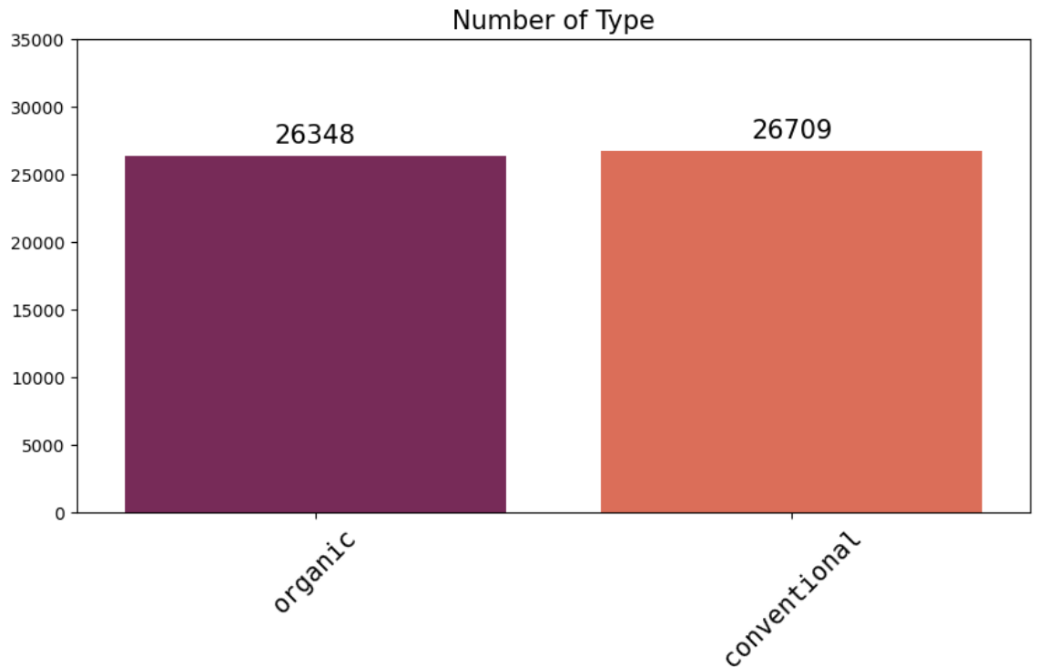
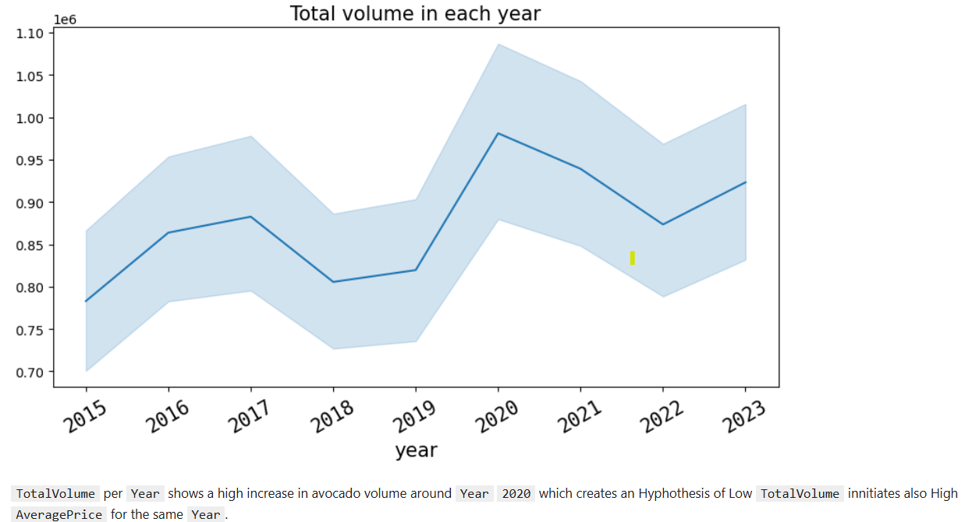
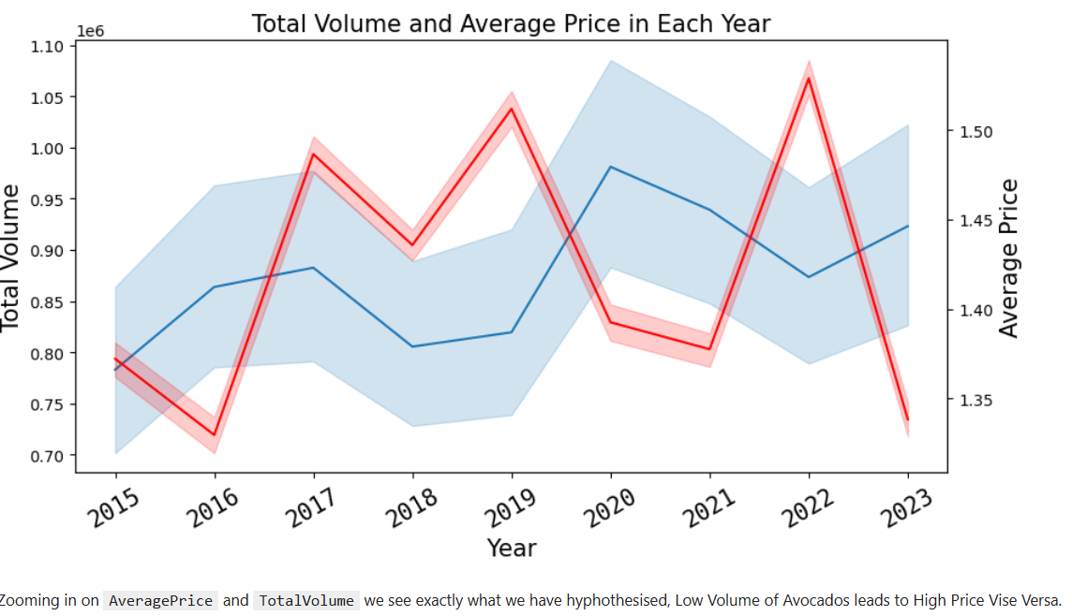
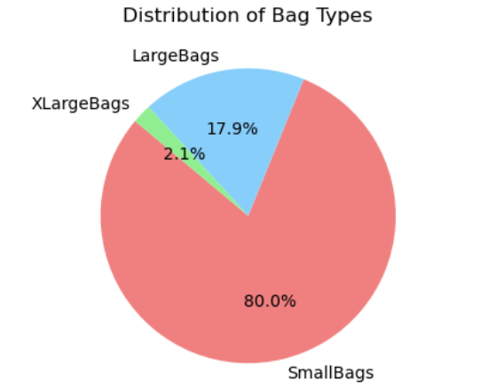
Exploratory Data Analysis (EDA)

Slide 8
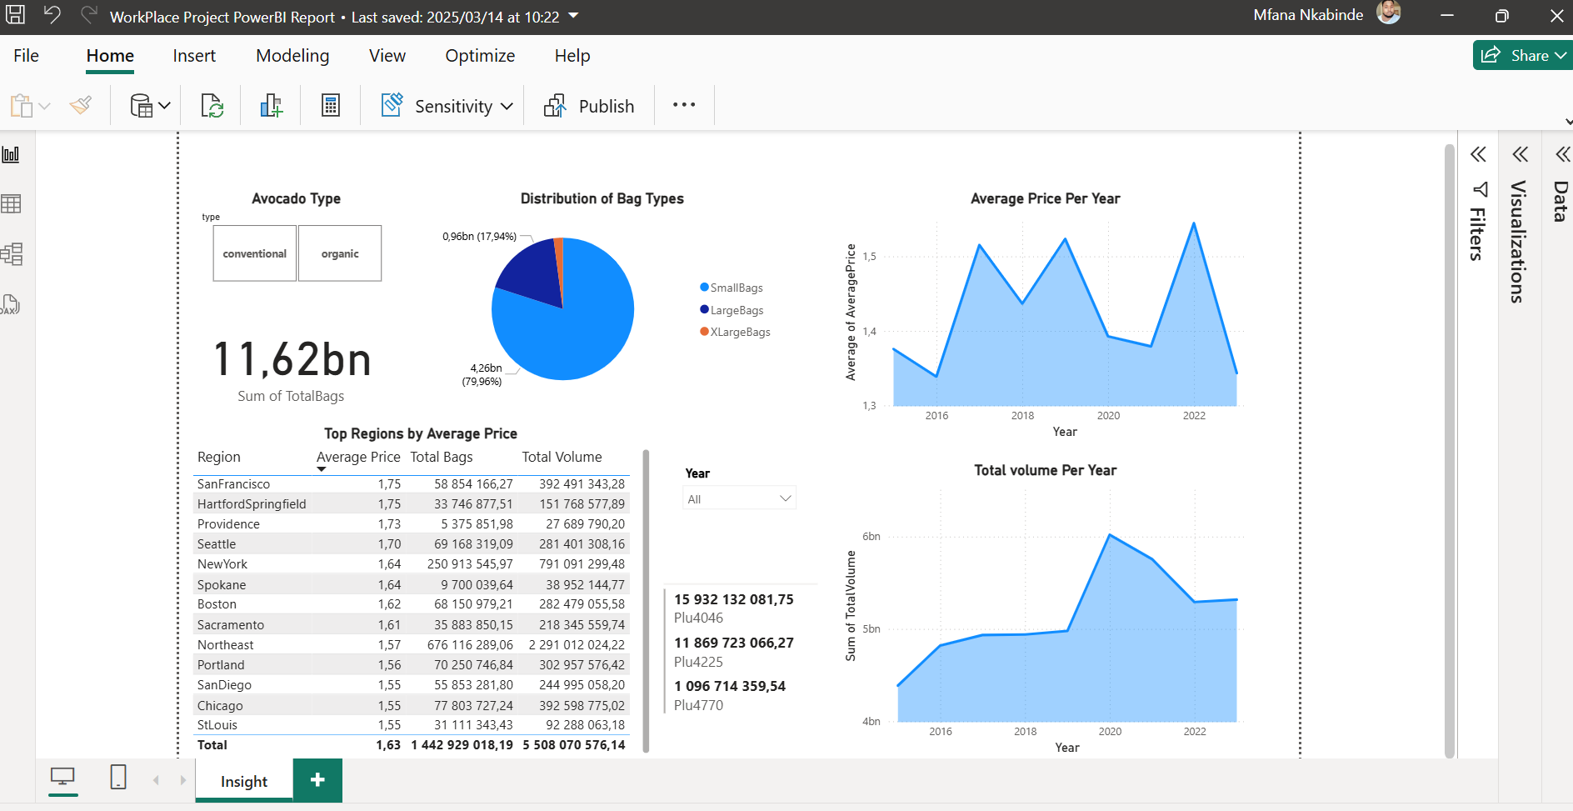
Power BI report

Slide 9
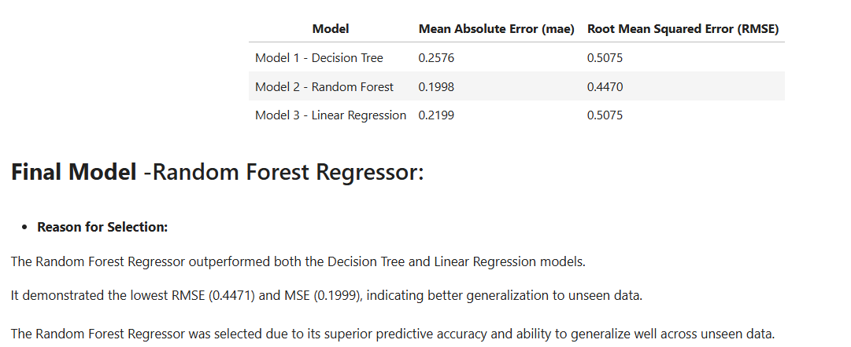
Modelling

Slide 10
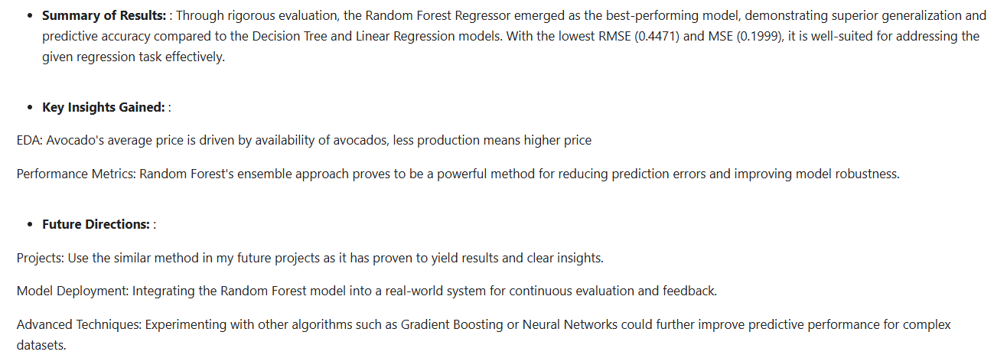
Conclusion and Future Work

Slide 11
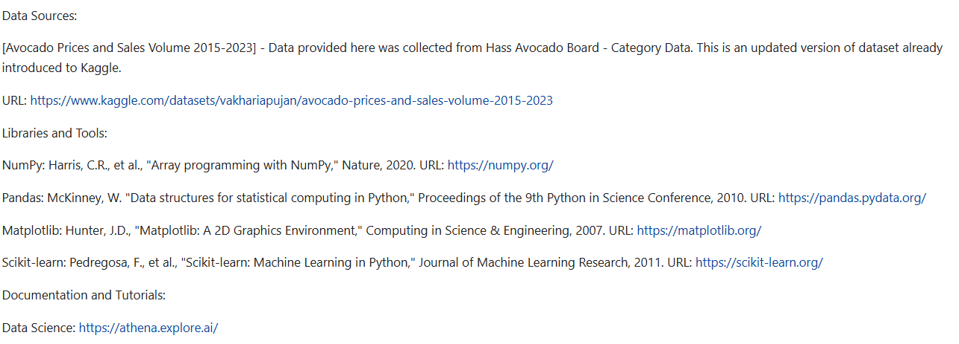
References

Slide 12
The end
Thank you.

